Slide 1


Game Engines 1
OpenGL, BGE & Component Based Games Engines
Dr Bryan Duggan
DIT School of Computing
bryan.duggan@dit.ie
@ditcomputing
http://facebook.com/ditschoolofcomputing

Slide 2
Questions we will answer today
How does BGE work?
How are 3D Graphics rendered?
Calculating the world transform
Calculating the view & projection transforms
Component based development
Examples in BGE
Generating the world transform
Generating the view & projection transforms

Slide 3
How does BGE Work?
OpenGL for rendering
Vertex shaders & Fragment shaders (OpenGL 4)
GLEW
The OpenGL Extension Wrangler Library (GLEW) is a cross-platform open-source C/C++ extension loading library. GLEW provides efficient run-time mechanisms for determining which OpenGL extensions are supported on the target platform. OpenGL core and extension functionality is exposed in a single header file. GLEW has been tested on a variety of operating systems, including Windows, Linux, Mac OS X, FreeBSD, Irix, and Solaris.
GLM
OpenGL Maths Library

Slide 4
SDL - Simple DirectMedia Library
A cross-platform multimedia library designed to provide fast access to the graphics framebuffer and audio device.
Initialises OpenGL
Creates the OpenGL context
Provides an abstraction for keyboard/mouse/joystick
SDL_TTF for TTF Font support
FMOD – Closed source Xplatform audio library
FMOD is a programming library and toolkit for the creation and playback of interactive audio.
MP3/WAV/MIDI playback
3D Audio
Occlusion/doppler/effects etc
Free for non-commercial use

Slide 5
Bullet
Bullet 3D Game Multiphysics Library provides state of the art collision detection, soft body and rigid body dynamics.
Rigid bodies, constraints etc
A solver

Slide 6
How are 3D Graphics Rendered in BGE?
Vertex data in world space
Screen
Vertex shader
Fragment Shader
Textures
Model/World Matrix
View Matrix
Projection Matrix
Normal Matrix
MVP Matrix

Slide 7
I prefer…
Vertices
Model
/World
View
Projection
Viewport
Clipping
The vertices
as they come out
of a 3D modelling
program.
The centre of
the model is
usually the
origin
Places the model
in the world
relative to all the
other objects
Transforms
everything
relative to the
camera (0,0,0)
looking down
the –Z Axis
Projects
everything
onto a
2D plane.
Far away
objects are
smaller
Often does
nothing special
but can be
a different
render target
(such as a texture)

Slide 8
What is a vertex shader?
Executed once for each vertex
The purpose is to transform each vertex's 3D position in virtual space to the 2D coordinate at which it appears on the screen (as well as a depth value for the Z-buffer).
Vertex shaders can manipulate properties such as position, color and texture coordinate, but cannot create new vertices

Slide 9
Fragment/pixel shaders
Compute colour of each pixel.
Can always outputting the same color,
Apply lighting (known as Phong shading) value
Bump mapping, shadows, specular highlights, translucency and other phenomena

Slide 10
Also… Geometry shaders
This type of shader can generate new graphics primitives, such as points, lines, and triangles, from those primitives that were sent to the beginning of the graphics pipeline
I don’t use them!

Slide 11
Shader Example
The vertex Shader:
#version 330 core
in vec3 vertexPosition_modelspace;
uniform mat4 MVP;
void main(){
// Output position of the vertex, in clip space : MVP * position
vec4 v = vec4(vertexPosition_modelspace,1); // Transform an homogeneous 4D vector, remember ?
gl_Position = MVP * v;
}
The Fragment Shader:
#version 330 core
// Ouput data
out vec3 color;
void main()
{
// Output color = red
color = vec3(1,1,0);
}
We will revisit this later in the course!

Slide 12
Calculating the world transform
Combination of the position, orientation and scale
Position & scale & vectors
Orientation is a quaternion
world = glm::translate(glm::mat4(1), position) * glm::mat4_cast(orientation) * glm::scale(glm::mat4(1), scale);

Slide 13
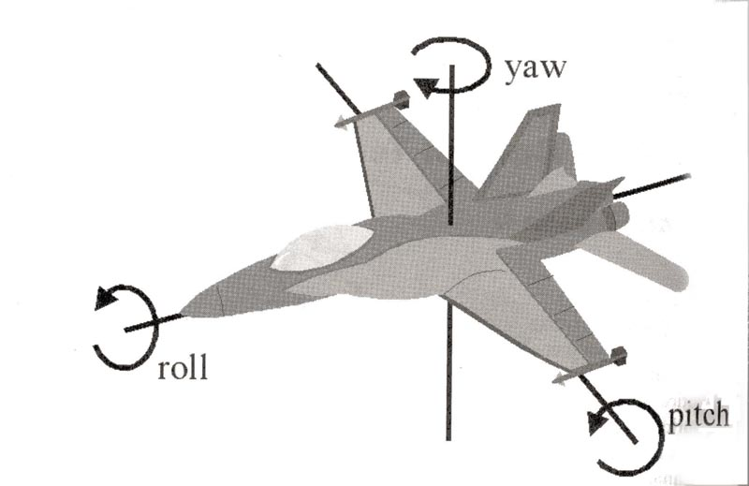
Movement/rotation with vectors
Walk
Strafe
Yaw
Pitch
Roll
Quaternion implementation to follow next week!

Slide 14
Walk
Move in the direction of the look vector..
void GameComponent::Walk(float units)
{
position += look * units;
moved = true;
}

Slide 15
Strafe & Fly
Movement in the direction of the right vector
void GameComponent::Strafe(float units)
{
position += right * units;
moved = true;
}
void GameComponent::Fly(float units)
{
position.y += units;
moved = true;
}

Slide 16
Yaw
Rotation around the Global Up vector:
glm::mat4 yaw;
yaw = glm::rotate(yaw, angle, GameComponent::basisUp);
glm::vec4 tlook = glm::vec4(look, 0);
tlook = yaw * tlook;
look = glm::vec3(tlook);
glm::vec4 tright = glm::vec4(right, 0);
tright = yaw * tright;
right = glm::vec3(tright);

Slide 17
Pitch
//Rotation around the RIGHT vector
glm::mat4 pitch;
pitch = glm::rotate(pitch, angle, right);
glm::vec4 tlook = glm::vec4(look, 0);
tlook = pitch * tlook;
look = glm::vec3(tlook);
glm::vec4 tup = glm::vec4(up, 0);
tlook = pitch * tup;
up = glm::vec3(tup);

Slide 18
Roll

Slide 19
Calculating the View Transform
view = glm::lookAt(
position
, position + look
, basisUp
);
GLM_FUNC_QUALIFIER detail::tmat4x4<T> lookAt
(
detail::tvec3<T> const & eye,
detail::tvec3<T> const & center,
detail::tvec3<T> const & up
)

Slide 20
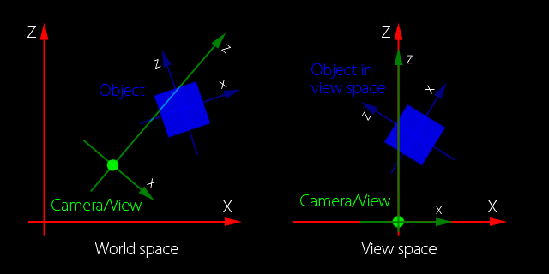
View Transform

Slide 21
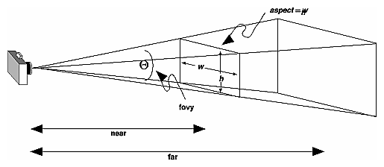
Calculating the Projection Transform
projection = glm::perspective(45.0f, 4.0f / 3.0f, 0.1f, 10000.0f);
GLM_FUNC_QUALIFIER detail::tmat4x4<valType> perspective
(
valType const & fovy,
valType const & aspect,
valType const & zNear,
valType const & zFar
)

Slide 22
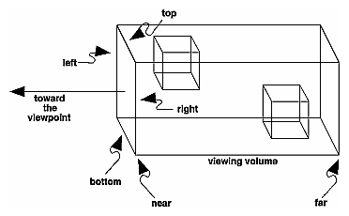
Orthographic projection
projection = glm::ortho(0.0f,800.0f, 400.0f, 0.0f, 0.1f, 10000.0f);
GLM_FUNC_QUALIFIER detail::tmat4x4<valType> ortho(
valType const & left,
valType const & right,
valType const & bottom,
valType const & top)
{

Slide 23
The Game loop
Initialise()
While (true)
Update(timeDelta)
Draw()
End while
Cleanup()

Slide 24
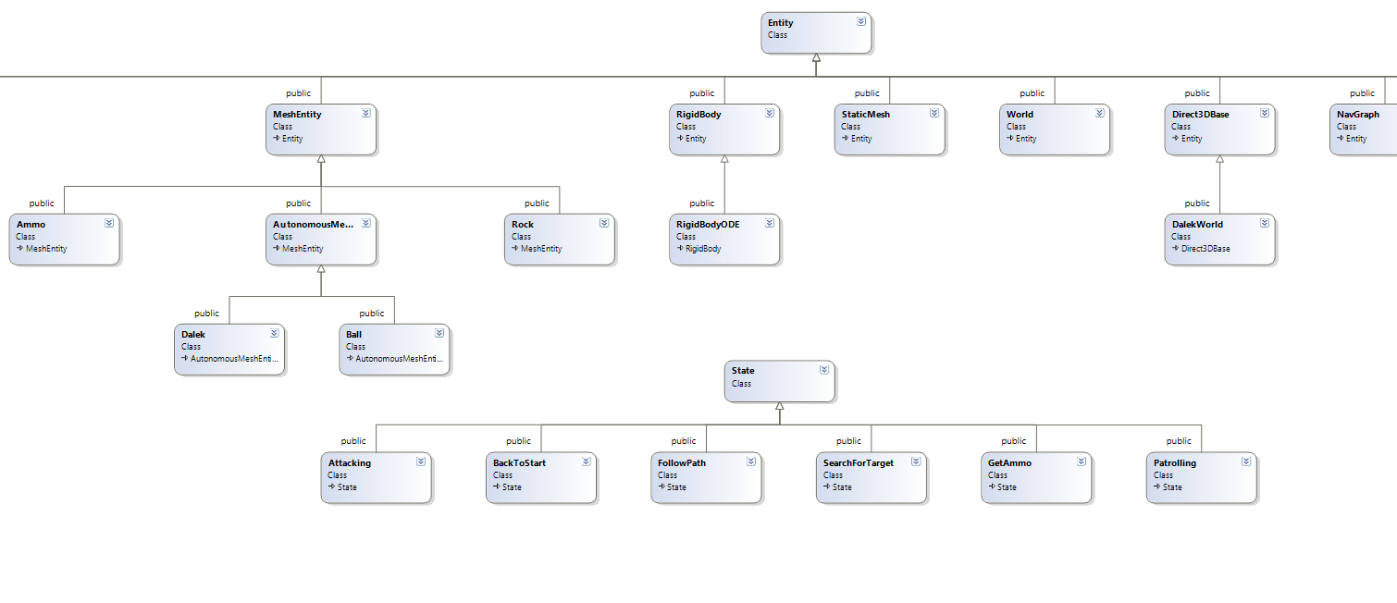
Object Oriented Game Engines
Are terrible. I know I made one (Dalek World)
Consider:

Slide 25
Problems!
Each new piece of functionality you want to add to a class becomes a new (more specific class)
Too many classes
No flexibility
Tight coupling

Slide 26
A better approach
The aggregate design pattern
Game Component
Initialise()
Update(timeDelta)
Draw()
Cleanup()
Attach(GameComponent c)
list<GameComponent> children
0..*

Slide 27
Component Based Games Engines
Everything in BGE is a component
Most things extend GameComponent
virtual bool Initialise();
virtual void Update(float timeDelta);
virtual void Draw();
virtual void Cleanup();
GameComponent’s keep track of a list of children components & parent component
std::list<std::shared_ptr<GameComponent>> children;
This is known as the aggregate design pattern

Slide 28
The base class GameComponent
Holds a list of GameComponent children references
Use Attach() to add something to the list.
Calls Initialise, Update and Draw on all children
All subclasses do their own work first then
Must call the base class member function so that the children get Initialised, Updated and Drawn!
Are these depth first or breadth first?
This means that the scene is a graph of objects each contained by a parent object
The parent object in BGE is the Game instance

Slide 29
bool GameComponent::Initialise()
{
// Initialise all the children
std::list<std::shared_ptr<GameComponent>>::iterator it = children.begin();
while (it != children.end())
{
(*it ++)->initialised = (*it)->Initialise();
}
return true;
}

Slide 30
void GameComponent::Cleanup()
{
// Cleanup all the children
std::list<std::shared_ptr<GameComponent>>::iterator it = children.begin();
while (it != children.end())
{
(*it ++)->Cleanup();
}
}
void GameComponent::Draw()
{
// Draw all the children
std::list<std::shared_ptr<GameComponent>>::iterator it = children.begin();
while (it != children.end())
{
if ((*it)->worldMode == GameComponent::from_parent)
{
(*it)->parent = this;
(*it)->UpdateFromParent();
}
(*it ++)->Draw();
}
}
The child object is controlled by the parent it is attached to
An example is a model

Slide 31
void GameComponent::Update(float timeDelta) {
switch (worldMode)
{
case world_modes::from_self:
world = glm::translate(glm::mat4(1), position) * glm::mat4_cast(orientation) * glm::scale(glm::mat4(1), scale);
break;
case world_modes::from_self_with_parent:
world = glm::translate(glm::mat4(1), position) * glm::mat4_cast(orientation) * glm::scale(glm::mat4(1), scale);
if (parent != NULL)
{
world = (glm::translate(glm::mat4(1), parent->position) * glm::mat4_cast(parent->orientation)) * world;
}
break;
case world_modes::to_parent:
world = glm::translate(glm::mat4(1), position) * glm::mat4_cast(orientation) * glm::scale(glm::mat4(1), scale);
parent->world = glm::scale(world, parent->scale);
parent->position = this->position;
parent->up = this->up;
parent->look = this->look;
parent->right = this->right;
parent->orientation = this->orientation;
break;
}
RecalculateVectors();
moved = false;
// Update all the children
std::list<std::shared_ptr<GameComponent>>::iterator it = children.begin();
while (it != children.end())
{
if (!(*it)->alive)
{
it = children.erase(it);
}
else
{
(*it ++)->Update(timeDelta);
}
}
}
The parent is
controlled by a child
The child is known
as a Controller

Slide 32
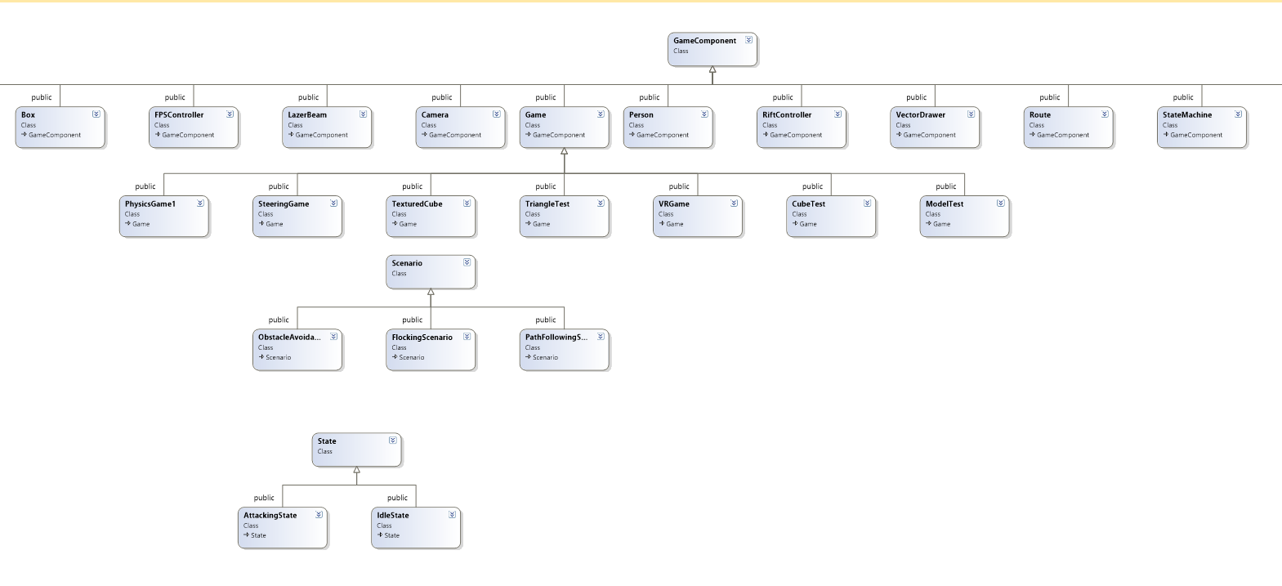

Slide 33
Each GameComponent has:
GameComponent * parent;
glm::vec3 position;
glm::vec3 look;
glm::vec3 up;
glm::vec3 right;
glm::vec3 scale;
glm::vec3 velocity;
glm::mat4 world;
glm::quat orientation;
glm::vec3 ambient;
glm::vec3 specular;
glm::vec3 diffuse;

Slide 34
Attaching!
You can attach a component to another component:
void GameComponent::Attach(shared_ptr<GameComponent> child)
{
child->parent = this;
children.push_back(child);
}

Slide 35
Categories of GameComponent
Depends on what they do with their world transform
from_self
from_self_with_parent
from_child
to_parent
from_parent
I am not entirely happy with this and it may change…

Slide 36
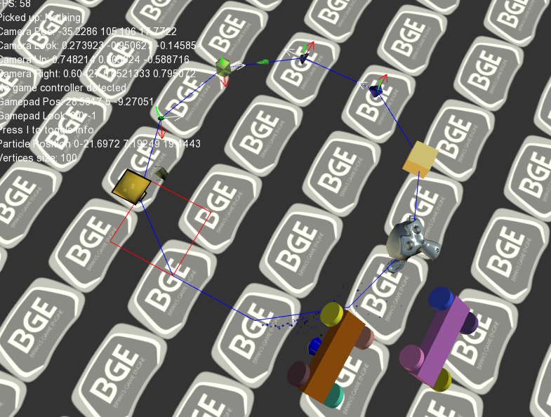

Slide 37
from_self
The default!
The components world transform is generated from its OWN:
Scale vector
Position vector
Quaternion
world = glm::translate(glm::mat4(1), position) * glm::mat4_cast(orientation) * glm::scale(glm::mat4(1), scale);

Slide 38
Example…
In Initialise
ship1 = make_shared<GameComponent>();
ship1->Attach(Content::LoadModel("cobramk3", glm::rotate(glm::mat4(1), 180.0f, glm::vec3(0,1,0))));
ship1->Attach(make_shared<VectorDrawer>(glm::vec3(5,5,5)));
ship1->position = glm::vec3(-10, 2, -10);
Attach(ship1);
In Update
ship1->position += ship1->look * speed * timeDelta;

Slide 39
from_self_with_parent
The component is attached to a parent
The parent is updated first
The components world transform is combined with the parents world transform
When the parent moves, the component moves relative to it
When the parent rotates, the component rotates relative to the parent
This is the standard in games engines such as Unity
We don’t want to include the parent’s scaling

Slide 40
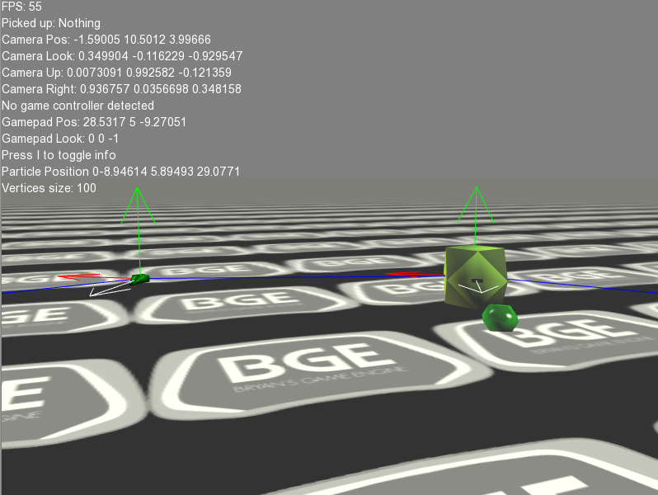

Slide 41
to_parent, from_child
The to_parent components are known as controllers
FPSController
XBOXController
SteeringController – Implements Steering behaviours
Steerable3DController – Implements the forward Euler/Hamiltonian Integrator
RiftController
PhysicsController – Rigid body physics

Slide 42
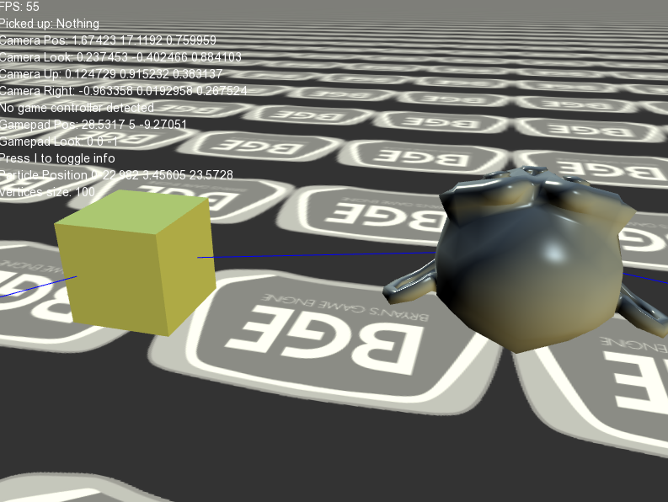

Slide 43
from_parent
Models encapsulate
Vertexbuffer
Texture
Texels
Diffuse colours
We only load one instance of each model, regardless of how many are drawn
This is called instancing
Created from the Content pipeline (static functions on the Content class)
Models can be attached to several different parents
Models always get their state from the parent

Slide 44
Making game objects from components
You can use these rules to assemble composite objects together. For example:
A component with a model attached and a steeringcontroller attached
The steeringcontroller sets the parent world transform
The model gets its world from the parent
You can attach different controllers to get different effects.
Examples…

Slide 45
2
3
4
1
10
5
9
6
11
7
8

Slide 46
Examples
1- from_self
GameComponent – from_self
Model – from_parent
VectorDrawer – from_parent
2 – a parent child
this is the standard implementation of a scene graph
GameComponent – from_self
Model- from_parent
VectorDrawer – from_parent
GameComponent – from_self_with_parent
A child that incorporates the parents position and orientation!

Slide 47
More examples
3 – A component with an XBOX Controller attached
GameComponent – from_child
XBOXController – to_parent
Model – from_parent
4 - A component with a Steerable3D controller attached
GameComponent – from_child
Steerable3DController – to_parent
Model – from_parent

Slide 48
More examples – using the PhysicsFactory
5 & 6 – Physics objects made with the PhysicsFactory
5 Box prefab – from_child
Model – from_parent
PhysicsController – to_parent
PhysicsControllers require some Bullet physics properties set. See later notes for info on these!
6 – A physics object made from a mesh
GameComponent – from_child
Model – from_parent
PhysicsController – to_parent

Slide 49
Using Physics constraints
7 & 8
Are boxes & cylinders made the same way as 5
The cylinders are attached via a hinge joint so that they wan rotate
8 has a model attached to the chassis via a from_self_with_parent relationship

Slide 50
Using steeringbehaviours
SteeringController implements lots of cool steering behaviours such as follow_path, seek, obstacle_avoidance
Its rule is to_parent so it is a Controller
Can be attached to anything and it will update the world transform of the thing it’s attached to
See 9 & 11 for examples
12 is just a textured model. Nothing special
An example in code…

Slide 51
//// from_self_with_parent
station = make_shared<GameComponent>();
station->worldMode = world_modes::from_self;
station->ambient = glm::vec3(0.2f, 0.2, 0.2f);
station->specular = glm::vec3(0,0,0);
station->scale = glm::vec3(1,1,1);
std::shared_ptr<Model> cmodel = Content::LoadModel("coriolis", glm::rotate(glm::mat4(1), 90.0f, GameComponent::basisUp));
station->Attach(cmodel);
station->Attach(make_shared<VectorDrawer>(glm::vec3(5,5,5)));
Attach(station);
// Add a child to the station and update by including the parent's world transform
std::shared_ptr<GameComponent> ship1 = make_shared<GameComponent>();
ship1->worldMode = world_modes::from_self_with_parent;
ship1->ambient = glm::vec3(0.2f, 0.2, 0.2f);
ship1->specular = glm::vec3(1.2f, 1.2f, 1.2f);
std::shared_ptr<Model> ana = Content::LoadModel("anaconda", glm::rotate(glm::mat4(1), 180.0f, GameComponent::basisUp));
ship1->Attach(ana);
ship1->position = glm::vec3(0, 0, -10); // NOTE the ship is attached to the station at an offset of 10
station->Attach(ship1);.

Slide 52
Summary
Know:
What libraries BGE uses
What shaders are
The rendering pipeline
The world, view & projection matrices
How to calculate
What the params mean
How component based game engines work
How to create composite game components

